Slide 1


Bellabeat Marketing Strategy Presentation
by Miya Ng

Slide 2

Introduction
1
Bellabeat is a wellness company focused on health tracking devices for women.
2
The goal of this study is to analyze user activity trends to optimize marketing strategies.

Slide 3

Problem Statement
Question
Objectives
How can user activity trends influence Bellabeat's marketing strategy?
Identify user engagement and retention trends.
Understand drop-off patterns to improve retention.
Use insights to enhance marketing strategies.

Slide 4
Data Collection & Processing
Data Sources
Preprocessing Steps
Fitbit Dataset (11 Tables)
Data cleaning (removing duplicates, handling missing values).
Formatting timestamps and fixing inconsistencies.
Identifying outliers and ensuring data accuracy.

Slide 5
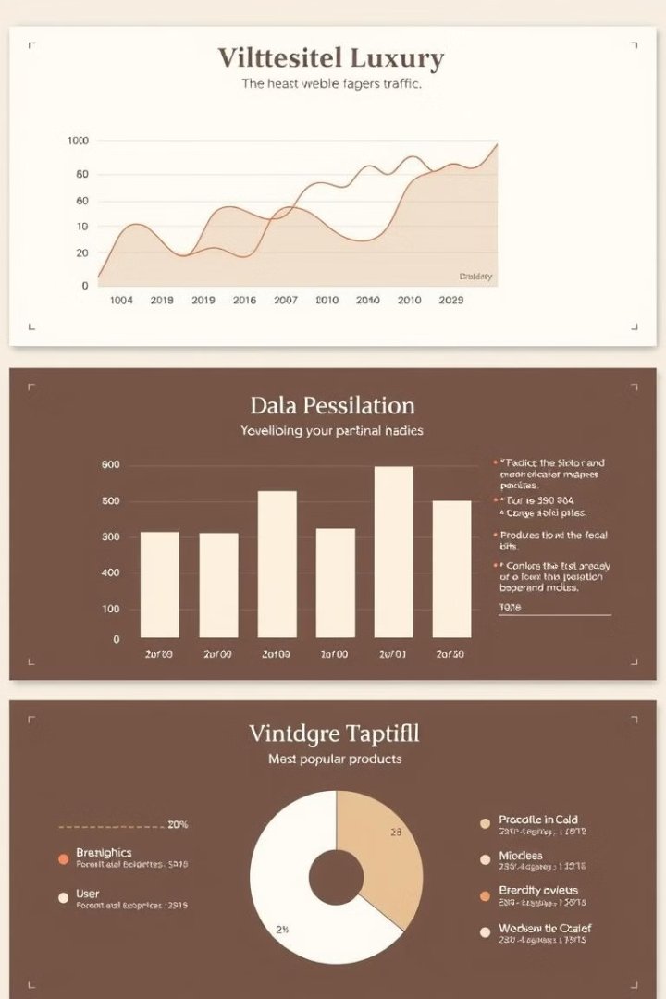
Exploratory Data Analysis (EDA)
1
User Consistency Trends
Identified drop-off patterns for retention.
2
Daily Engagement Rate
Measured how often users engage with their devices.
3
Activity & Step Trends
Observed daily movement patterns.

Slide 6
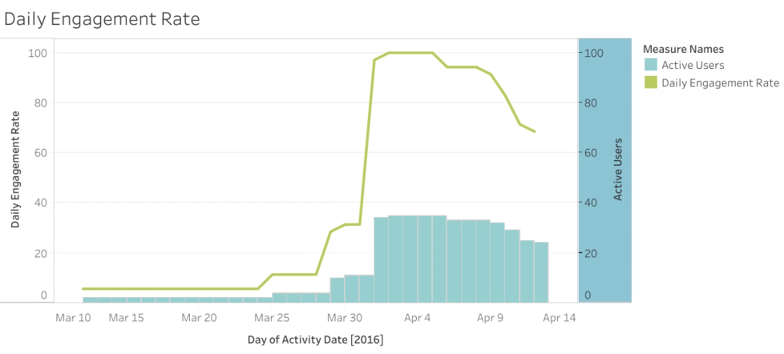
Data Visualization - Daily Engagement Rate
Insights:
Initial engagement was low but increased significantly after March 30.
Peak engagement was observed from April 1 to April 6, with 100% engagement.
Gradual decline in engagement post-April 6.

Slide 7

Interpretation of Insights
Adoption Pattern
Consistent engagement increased as more users actively adopted the device.
Marketing Impact
Marketing campaigns or product launches might have influenced engagement spikes.
Retention Need
Drop-offs indicate the need for retention strategies like personalized reminders and incentives.

Slide 8



Recommendations for Marketing Strategy
Product Enhancements
Introduce gamification to make daily activity more engaging.
1
Improve UI/UX to encourage consistent use.
Targeted Campaigns
2
Focus marketing efforts on key periods where engagement is high.
Introduce new challenges or events to sustain engagement.
Retention Strategies
3
Implement personalized notifications and goal-setting reminders.
Offer rewards for consistent activity over time.

Slide 9



Conclusion
Retention Improvement
2
Personalized strategies can boost retention
Marketing Opportunities
1
Engagement trends highlight key opportunities
Enhanced Experience
Data-driven marketing improves user experience
3

Slide 10
Q&A
Thank you! Questions?

